Slide 1
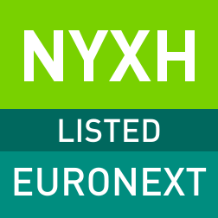
Nyxoah Overview
January 2026

Slide 2
Forward-Looking Statements
Please read the following before continuing. This presentation has been prepared by the management of Nyxoah SA (“we,” “us” or the "Company"). It does not constitute or form part of, and should not be construed as, an offer, solicitation or invitation to subscribe for, underwrite or otherwise acquire, any securities of the Company or any member of its group nor should it or any part of it form the basis of, or be relied on in connection with, any contract to purchase or subscribe for any securities of the Company or any member of its group, nor shall it or any part of it form the basis of or be relied on in connection with any contract or commitment whatsoever. It is not a prospectus or offering memorandum.
The information included in this presentation has been provided to you solely for your information and background, speaks as of the date delivered or presented to you by the Company, and is subject to updating, completion, revision and amendment and such information may change materially from time to time. No person is under any obligation to update or keep current the information contained in this presentation and any opinions expressed in relation thereto are subject to change without notice. No representation or warranty, express or implied, is made as to the fairness, accuracy, reasonableness or completeness of the information contained herein. Neither the Company nor any other person accepts any liability for any loss howsoever arising, directly or indirectly, from this presentation or its contents.
This presentation include statements that are, or may be deemed to be, "forward-looking statements“ within the meaning of The Private Securities Litigation Reform Act of 1995, as amended. In some cases, forward-looking statements can be identified by the use of forward-looking terminology, including the words "believes," "estimates," "anticipates," "expects," "intends," "may," "will,“ "plans," "continue," "ongoing," "potential," "predict," "project," "target," "seek" or "should" or, in each case, their negative or other variations or comparable terminology or by discussions of strategies, plans, objectives, targets, goals, future events or intentions. Forward-looking statements include statements regarding the Company's intentions, beliefs or current expectations concerning, among other things, the Company's results, condition, performance, prospects, growth, strategies and the industry in which the Company operates. By their nature, forward-looking statements involve known and unknown risks and are subject to uncertainties and assumptions. New risks can emerge from time to time, and it is not possible for the Company to predict all such risks. The Company cannot assess the impact of all such risks and uncertainties on its business or the extent to which any risks or uncertainties, or combination of risks or uncertainties and other factors, may cause the Company's actual results, condition, performance, prospects, growth or opportunities, as well as those of the markets it serves or intends to serve, to differ materially from those contained, expressed or suggested in any forward-looking statements in this presentation. Forward-looking statements are not guarantees of future performance. Even if the Company's results, condition, and growth and the development of the industry in which the Company operates are consistent with the forward-looking statements contained in this presentation, those results or developments may not be indicative of results or developments in future periods. Given these risks and uncertainties, the reader should not rely on forward-looking statements as a prediction of actual results. The Company and each of its directors, officers and employees expressly disclaim any obligation or undertaking to review, update or release any update of or revisions to any forward-looking statements in this presentation or any change in the Company's expectations or any change in events, conditions or circumstances on which these forward-looking statements are based, except as required by applicable law or regulation. More detailed information about the risks and uncertainties affecting the Company is contained in filings the Company has made and may make with the U.S. Securities and Exchange Commission in the future or in documents that the Company has published or may publish on its website.
This document and any materials distributed in connection with this document are not directed to, or intended for distribution to or use by, any person or entity that is a citizen or resident or located in any locality, state, country or other jurisdiction where such distribution, publication, availability or use would be contrary to law or regulation or which would require any registration or licensing within such jurisdiction. The distribution of this document in certain jurisdictions may be restricted by law and persons into whose possession this document comes should inform themselves about and observe any such restrictions. The Company cannot be held liable should these restrictions be breached by any person.
This presentation shall not constitute an offer to sell or the solicitation of an offer to buy, nor shall there be any sale of these securities in any state or other jurisdiction in which such offer, solicitation or sale would be unlawful prior to registration or qualification under the securities laws of any such state or other jurisdiction.

Slide 3
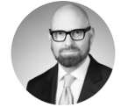
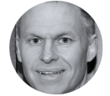

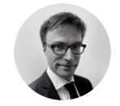


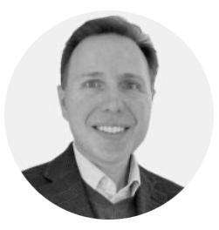

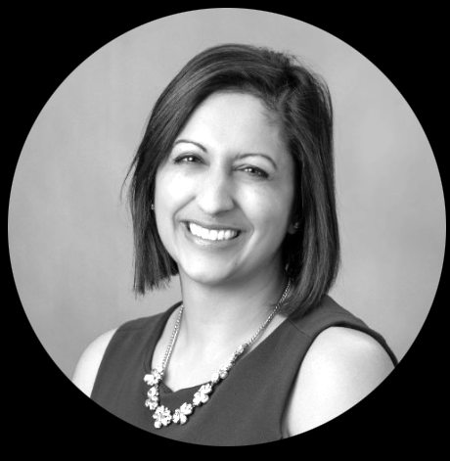
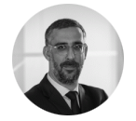
Seasoned Management Team
Experienced Medtech leader, appointed CEO of Nyxoah in 2019.
25 years of Pharma and Medtech experience with leadership roles at Medtronic, Stryker, Nevro and Eli Lilly
Transformed NYXH from a pioneering private MedTech company into a global public company, through 2 successful IPOs on Nasdaq and Euronext Brussels
Led Genio® to FDA PMA approval in August 2025
Scott Holstine Chief Commercial Officer
– Teleflex, St. Jude Medical –
Dr. Mau Boon Chief Medical Officer
– Thomas Jefferson University –
Jey Subbaroyan Chief Clinical Officer
– Nevro, J&J –
Olivier Taelman Chief Executive Officer
Bruno Onkelinx Chief Technology Officer
– Cochlear –
Maggie McGowan Chief HR Officer
– Novartis –
Loïc Moreau President International
– GSK, PWC –
20 years of financial leadership experience in the healthcare and medtech sectors
Proven track record of driving growth and operational efficiency in public and private companies
Expert in executing financial strategies that support significant revenue growth and market share expansion in the U.S. market
John Landry
Chief Financial Officer
An Moonen General Counsel
– Linklaters–
Geeta Kaveti Chief Compliance Officer
– Nevro, Abbott, U.S. Dept. of Health –
Rémi Renard Chief IR & Corp Comm Officer
– ResMed, St. Jude Medical –

Slide 4
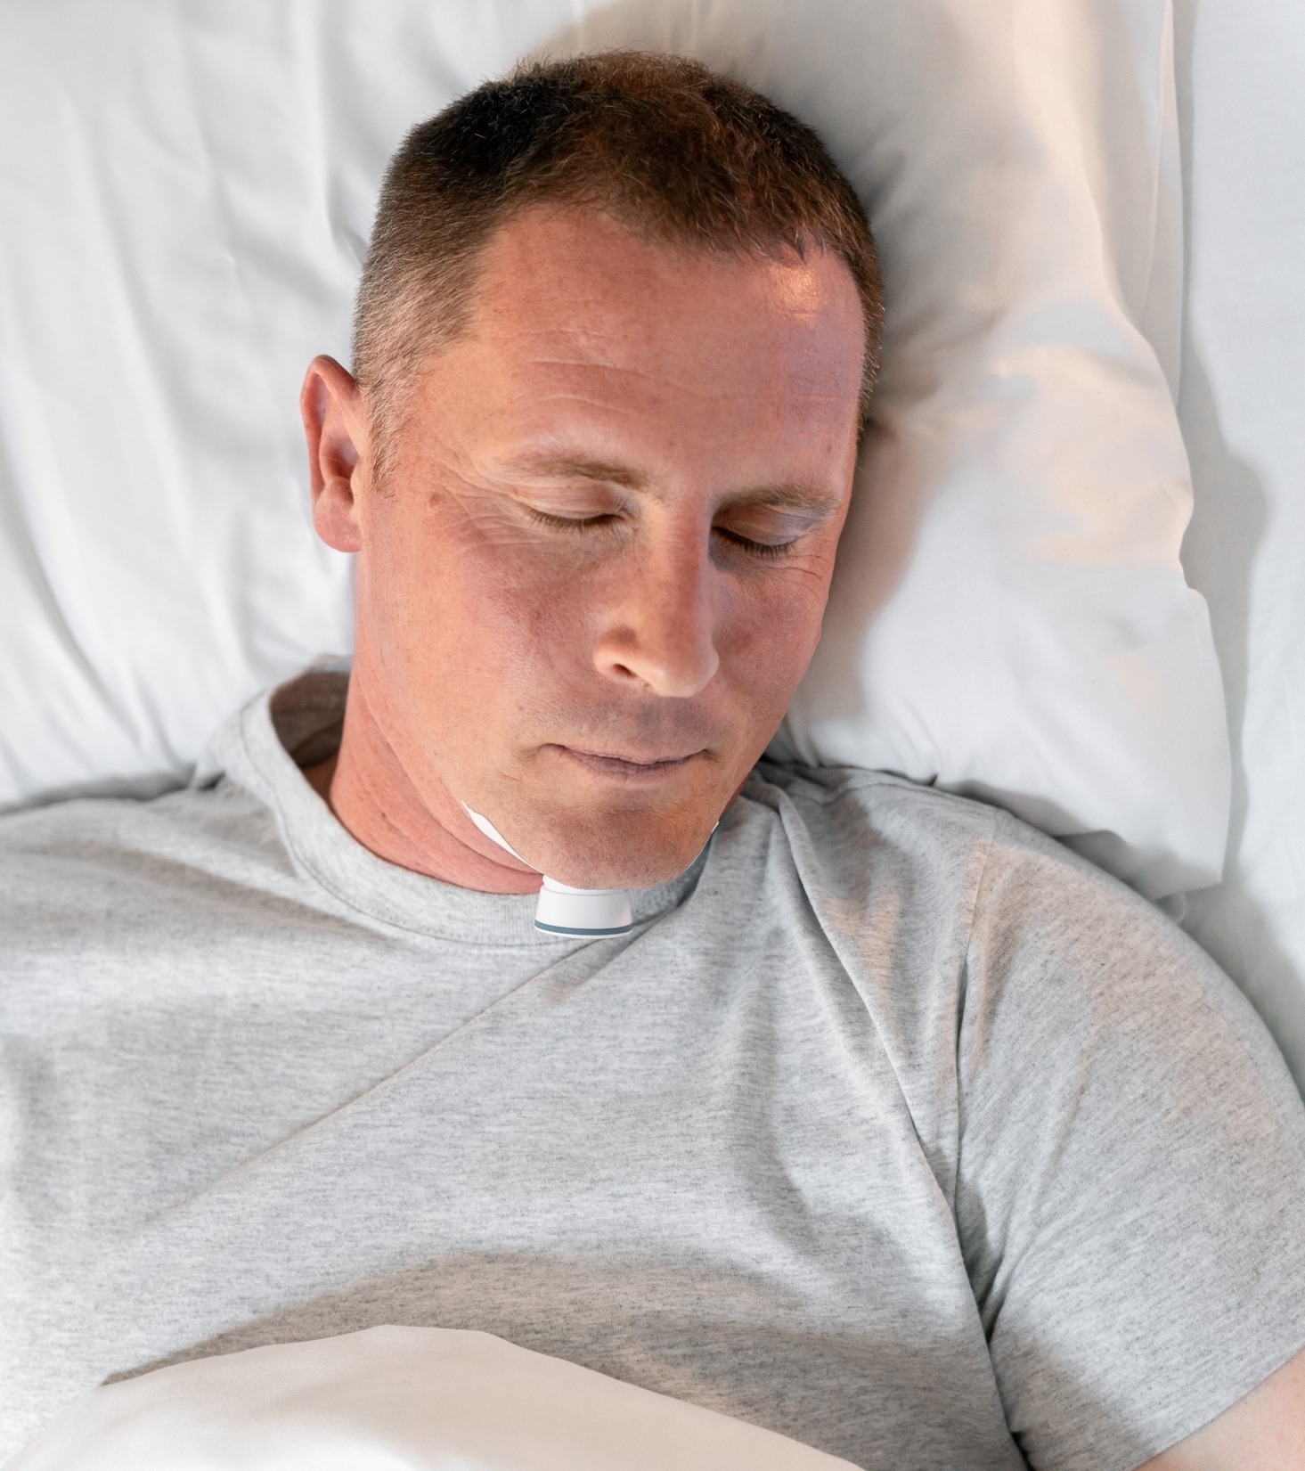
Our vision is to make sleep simple
Nyxoah is a MedTech company with a unique neuromodulation solution for Obstructive Sleep Apnea, putting the patient first.

Slide 5




Nyxoah’s Blueprint for Success
Obstructive Sleep Apnea is a $10B U.S. annual blockbuster market opportunity*, largely underpenetrated, fast growing and Nyxoah actively launching as second player
A completely differentiated patient-first technology: safe, effective and minimally invasive by design
1000+ patients treated in Europe
Commercially reimbursed in Germany, UK, Netherlands and UAE
FDA Approved August 2025 and actively launching with a dedicated U.S. commercial team
US Reimbursement Secured – CPT code endorsed by CMS and Private Payers
* Based on internal estimates

Slide 6
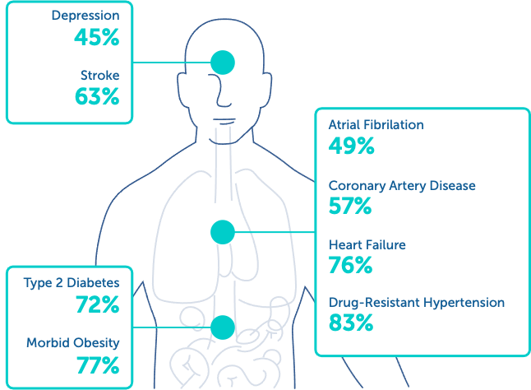
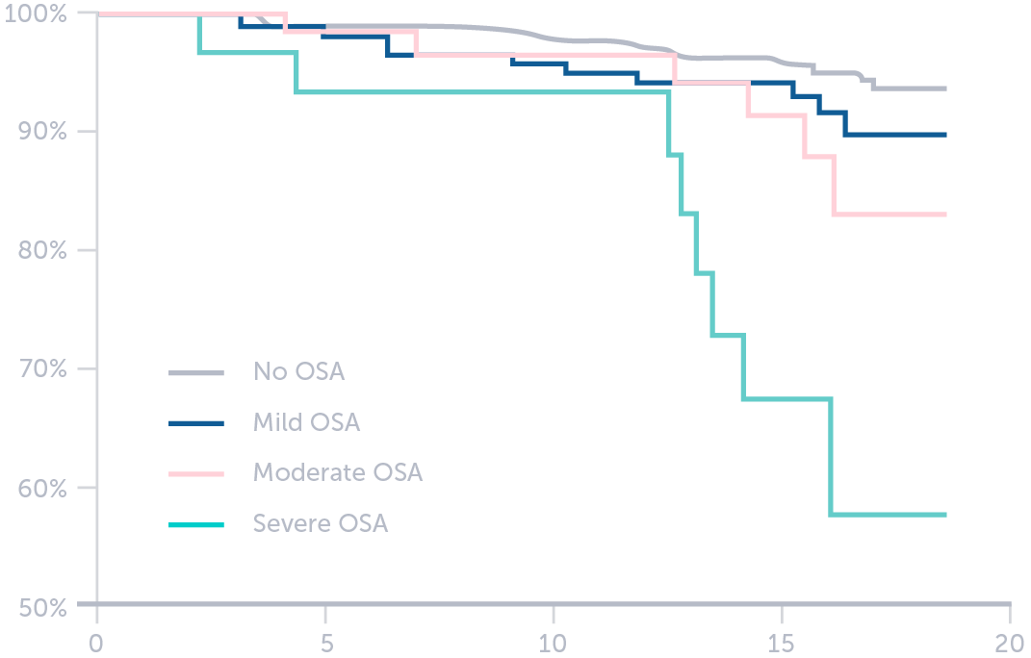
Obstructive Sleep Apnea Patients Need Treatment
Obstructive Sleep Apnea (OSA) is a common, chronic disorder where the upper airway repeatedly collapses during sleep, interrupting breathing. Beyond significant quality of life impacts, poorly treated OSA can lead to severe health complications.
Associated with Higher Mortality^{1,2}
Increased Risk of Comorbidities
Highly Prevalent in Key Chronic Diseases⁵
0-4 | Normal Range
5-14 | Mild Sleep Apnea
15-30 | Moderate Sleep Apnea
>30 | Severe Sleep Apnea
5x
2.5x
2x
Survival Rate – %
3
4
3
Time – Years

Slide 7

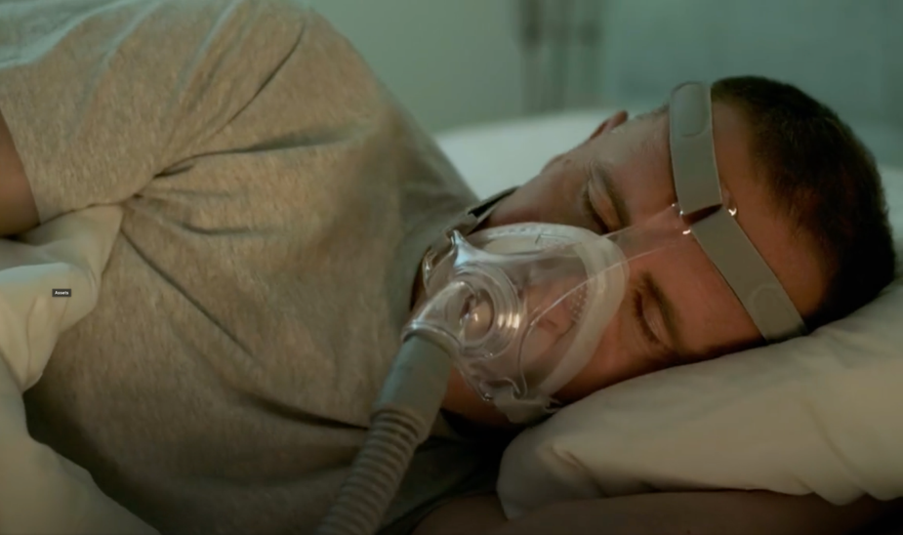
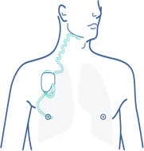

What are the existing OSA treatment options
Mandibular Advancement Devices
Standard of Care First Line Therapy: Continuous Positive Airway Pressure (CPAP)
Mostly suitable for mild to moderate OSA
Non-predictive therapy efficacy
High out-of-pocket cost to patient
Unilateral Hypoglossal Nerve Stimulation (Uni-HGNS)
Suitable for moderate to severe OSA¹¹
Multiple incisions with an implanted battery
MRI compatibility restrictions
Therapy efficacy dependent of patient compliance – “Dose/Response effect”⁷
Compliance definition: At least 4 hours/night for 5 nights/week)⁷
CPAP non-compliance estimated to be between 29% and 83%^{7, 8, 9}
Traditional Surgery
Highly invasive and remains last resort
30% to 60%¹² success rate
High incidence of side effects

Slide 8

Make Sleep Simple
A Completely Differentiated Patient-First Technology

Slide 9
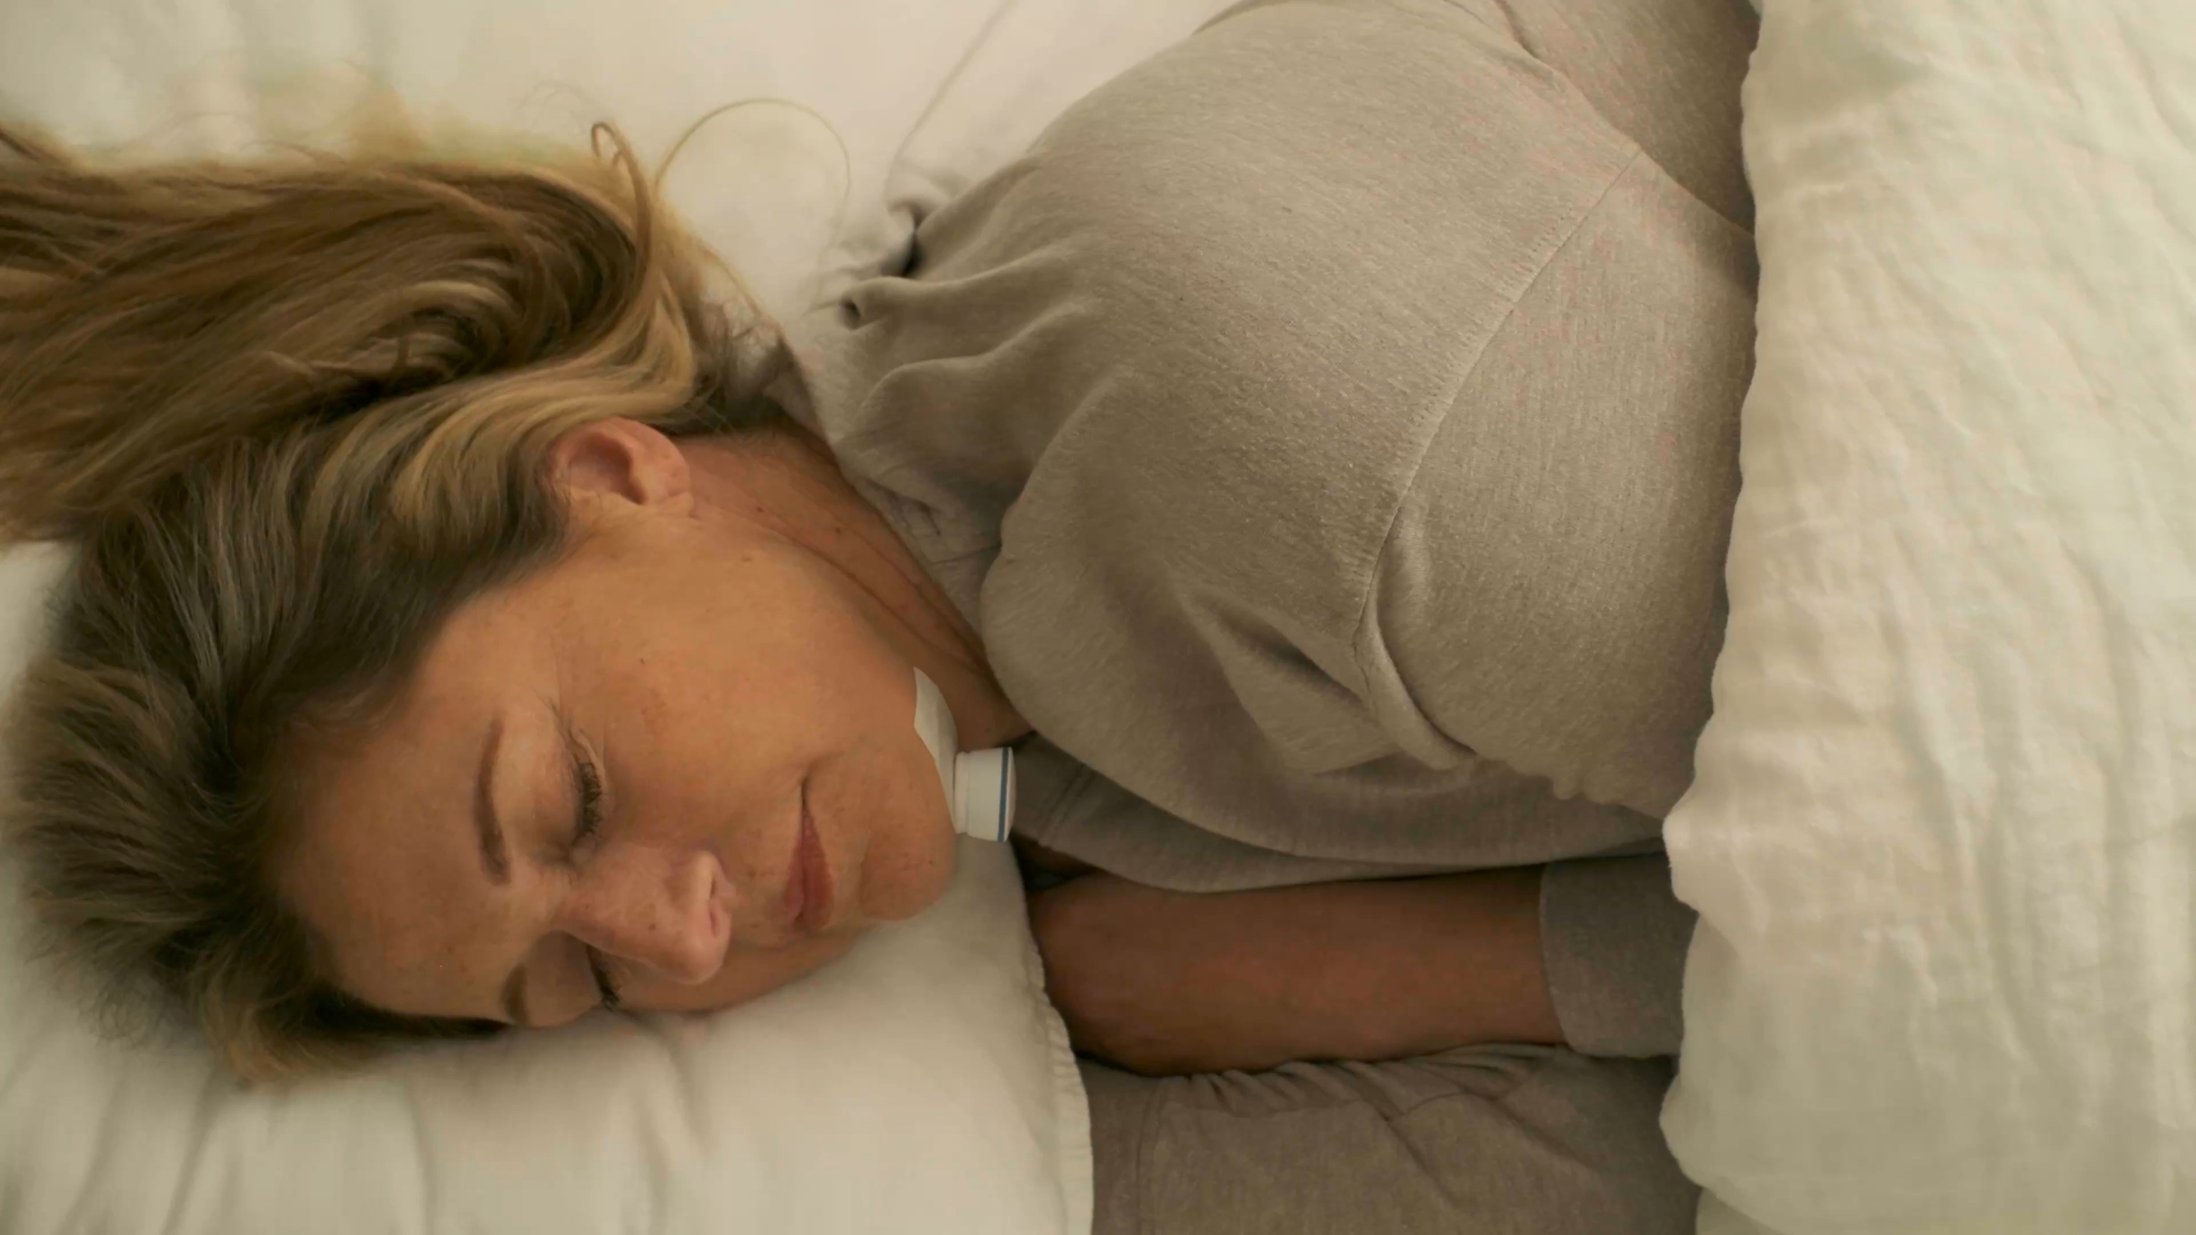
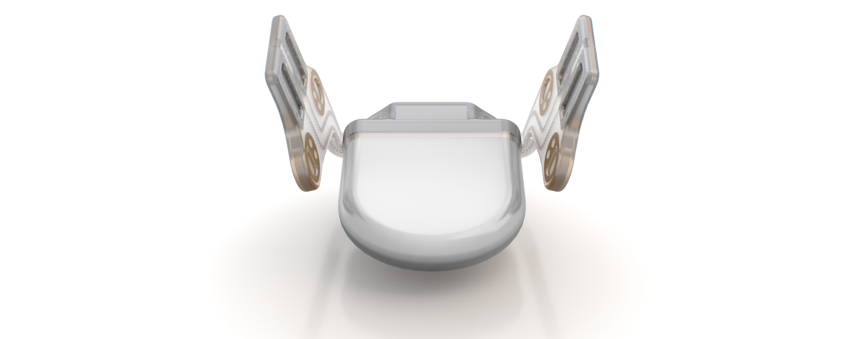

A Completely Differentiated Patient-First Technology
1.5T & 3T Full-body MRI compatible
No implanted battery
Bilateral nerve stimulation

Slide 10

A Completely Differentiated Patient-First Technology
Smart Sleep Wearable
Intelligent control of the implant
Externally powers the passive implant

Slide 11
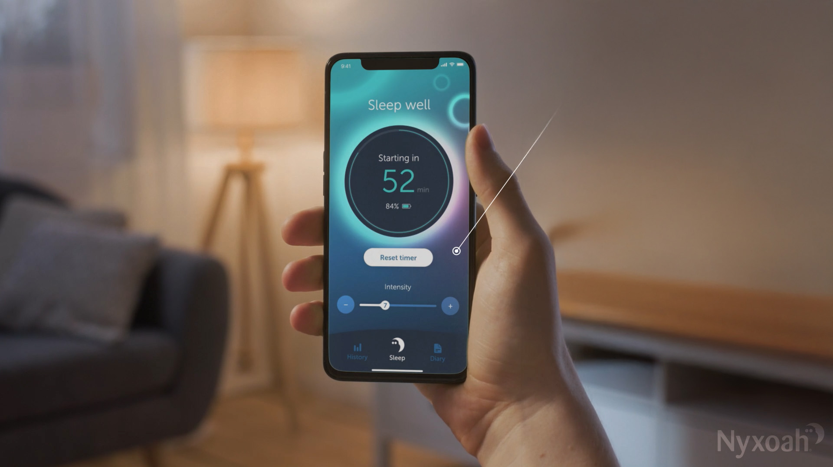
mw
A Completely Differentiated Patient-First Technology
Intuitive app
Monitor sleep
Personalize stimulation
Capture data
Empowers the Patient to Help Drive Compliance

Slide 12

(Photo, then implant with bilateral MOA)
A Completely Differentiated Patient-First Technology
Travel friendly
Scalable platform
Implant for life concept

Slide 13
DREAM Clinical Study

Slide 14
Compelling Clinical Evidence US Pivotal DREAM Study Achieved Safety and Efficacy Endpoints
Overall 70.8% Median AHI Reduction at 12 Months
66.6% Median AHI Reduction in Supine at 12 Months
82% of Patients with
AHI Below 15 at 12 Months
P<0.001
12 Month
(N=89)
P<0.001

Slide 15
U.S. Commercialization
Confidential

Slide 16
U.S. Commercialization Focused launch strategy on high volume implant sites
Smart Follower Strategy – 2-pronged approach
Focus on top 400 high-volume HGNS implanting accounts representing circa 70% of total HGNS volume
Referral strategy with sleep physicians focused on driving CPAP quitters to Genio centers, supported by targeted DTC
US Nyxoah Commercial Team
Commercial organization of 60+ people
40 Territory Managers targeting high volume implanting accounts and driving referrals from sleep centers
Dedicated Market Access team supporting reimbursement submissions
Marketing, Field Training & Education team
Reimbursement
Using established CPT code 64568 recognized by payers for HGNS
Secured reimbursement from CMS and Private Payers (United Healthcare, BCBS, Anthem and Cigna)

Slide 17
Why Invest In Nyxoah
Obstructive Sleep Apnea is a $10B U.S. annual blockbuster market*, largely underpenetrated, fast growing
Nyxoah enters as the second market participant breaking a single company dynamic
A completely differentiated patient-first technology: safe, effective and minimally invasive by design
Nyxoah brings optionality to patients and physicians in a market served by limited treatment options
Evolving from a clinical-stage into a commercial-focused global public company
Nyxoah has proven commercial success in multiple international countries with 1,000+ patients treated
FDA Approved since August 2025 and US Reimbursement Secured with CMS and Private Payers
Nyxoah actively launching and building strong U.S momentum with a first full quarter of commercialization
* Based on internal estimates

Slide 18
References
Sources
DREAM Study Design Details
Young T. et al: Sleep Disordered Breathing and Mortality: Eighteen-Year Follow-up of the Wisconsin Sleep Cohort, Sleep. 2008 Aug 1; 31(8): 1071–1078.
Al Lawati NM, Patel SR, Ayas NT. Epidemiology, risk factors, and consequences of obstructive sleep apnea and short sleep duration. Prog Cardiovasc Dis 2009;51:285–293.
Wake up America: a national sleep alert : report of the National Commission on Sleep Disorders Research (1994).
Daniel Bratton. CPAP vs MA Devices and Blood Pressure in Patients With Obstructive Sleep Apnea. A Systematic Review and Meta-analysis. Jama 2015
Logan et al. J. Hypertension; O’Keefe and Patterson, Obes Surgery; Oldenburg et al,, Eur J Heart Failure; Einhorn et al. Endocrine Prac; Basseti et al. Stroke.
Medicare Revised Guidelines for CPAP Therapy in the home
Kribbs NB, Pack AI, Kline LR, Smith PL, Schwartz AR, Schubert NM, Redline S, Henry JN, Getsy JE, Dinges DF. Objective measurement of patterns of nasal CPAP use by patients with obstructive sleep apnea. Am. Rev. Respir. Dis. 1993; 147: 887–95.
Sawyer AM, Gooneratne NS, Marcus CL, Ofer D, Richards KC, Weaver TE. A systematic review of CPAP adherence across age groups: clinical and empiric insights for developing CPAP adherence interventions. Sleep Med. Rev. 2011; 15: 343–56
Weaver TE, Grunstein RR. Adherence to continuous positive airway pressure therapy: the challenge to effective treatment. Proc. Am. Thorac. Soc. 2008; 5: 173–8
Hoffstein, V, Review of oral appliances for treatment of sleep-disordered breathing. Sleep Breath 2007; 11(1): 1-22
Inspire Medical 3028 – System Implant Manual
Shah, Janki, et al; American Journal of Otolaryngology (2018). Uvulopalatopharyngoplastyvs CN XII stimulation for treatment of obstructive sleep apnea: A single institution experience
DESIGN
n=115
Pivotal, multi-center, prospective, open-label study
Safety and performance of bilateral HGNS system in adult patients
Patients must sleep supine for at least 60 minutes at their 12-month PSG
All assessments from consent (safety) or baseline (efficacy) to 12 months post-implant
All safety events were adjudicated by an independent Clinical Events Committee (CEC)
BASELINE CHARACTERISTICS
Mean
Mean Baseline AHI: 28.0 events/h
Mean Baseline ODI: 27.0 events/h
Mean BMI: 28.5 kg/m2
EFFICACY ENDPOINTS
Co-Primary – AHI responder rate at 12 months per the Sher criteria (AHI reduction of at least 50% from baseline on the 12-month PSG and AHI score of less than 20 events per hour on the 12-month PSG)
Co-Primary – ODI responder rate at 12 months (ODI reduction of at least 25% from baseline on the 12-month PSG)
Secondary – Median reduction in AHI from baseline to 12 months
SAFETY ENDPOINTS
Incidence of device-related serious adverse events (SAEs)
Adjudicated by an independent clinical events committee (CEC)

